Slide 1


Team 30: ECEN 215 Lab Kit
Bi-Weekly Update 5 Members: Luis Diaz-Santini, Yusuf Hossain,
Ryan Freed, and Peter Zhang Sponsor: Dr. Lusher
TA: Garret Brown
Notes:
Intro should take 30 seconds

Slide 2
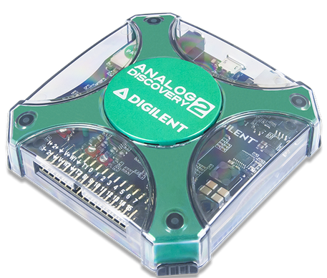
Project Summary
Problem Statement:
Principles of Electrical Engineering (ECEN 215) teaches the basics of electric circuit analysis and electronics to non-ECEN majors.
The transition of ECEN 215 to an online format poses a challenge due to its lab component relying on the Analog Discovery 2 (AD2), which is expensive.
Solution Proposal:
The ECEN 215 Lab Kit offers a solution to the cost, convenience, and over complication issues that are abundant with the AD2. Aiming for a $50 price point, the lab kit offers a more catered simpler approach to each lab while also making it possible to complete at home.
Will operate as the power supply, signal generator, multimeter, and Oscilloscope.

Slide 3
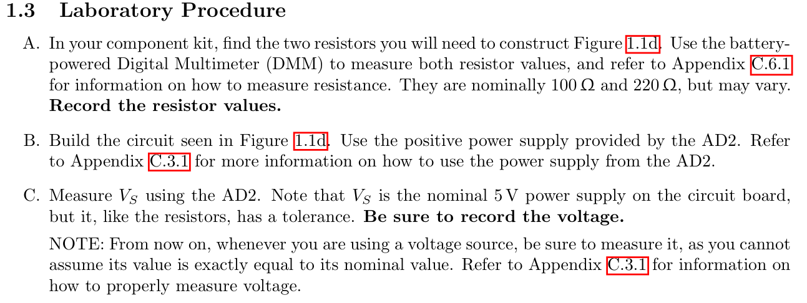
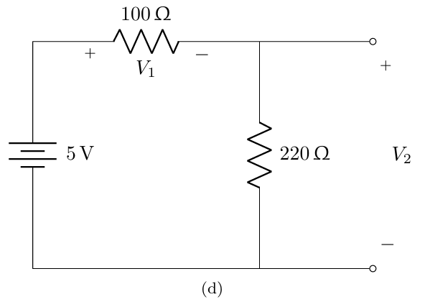
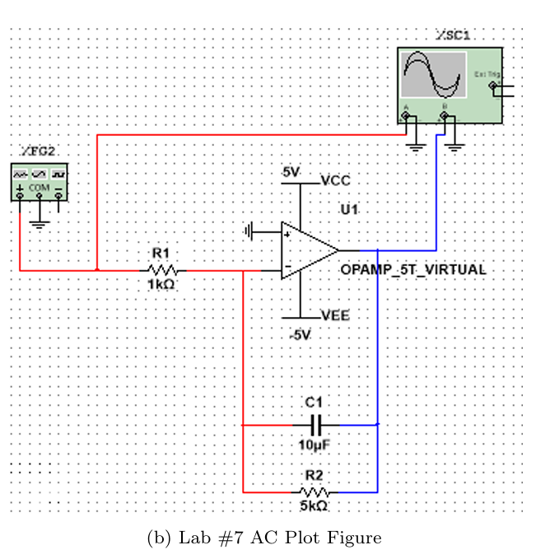
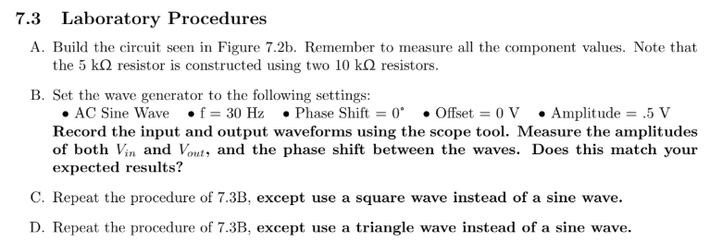
Example Lab

Slide 4
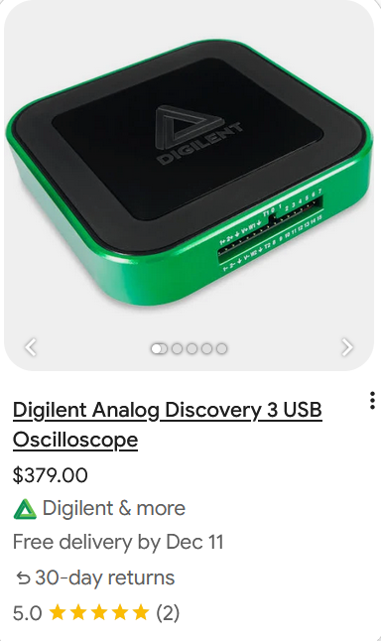
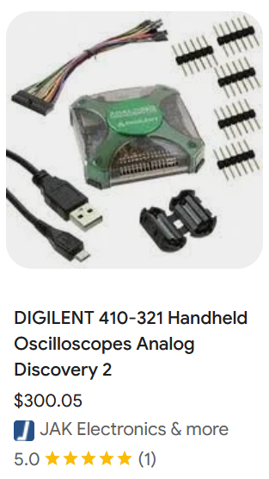
Alternatives

Slide 5
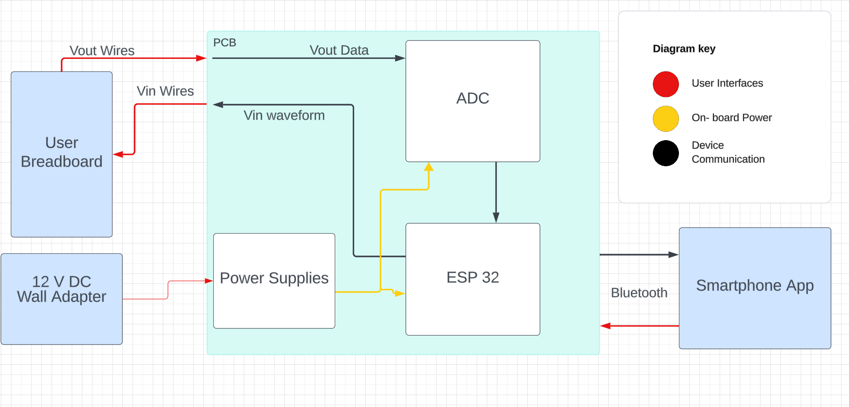
Solution Overview
Peter: Multimeter and Oscilloscope
Yusuf: Waveforms and communicating to the microcontroller.
Luis: Mobile application to interface with device
Ryan: PCB design and power.

Slide 6
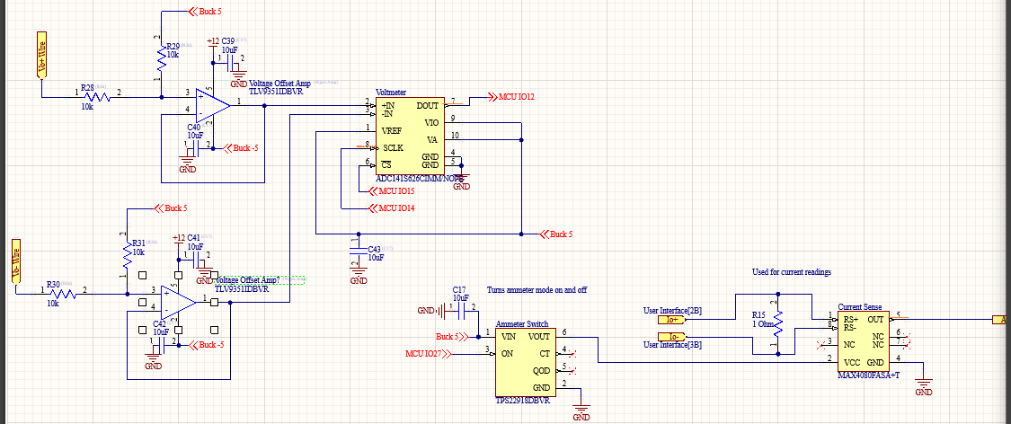
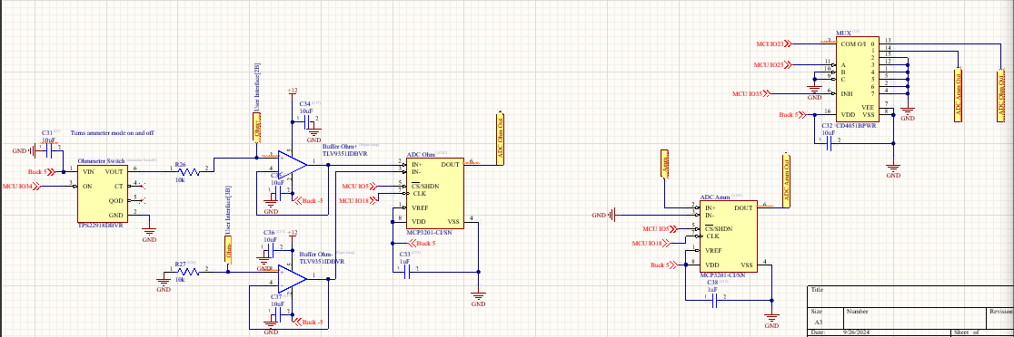
Oscilloscope and Multimeter
Peter Zhang
Accomplishments:
Design Multimeter (Ammeter, Ohmmeter, Voltmeter)
Design Oscilloscope
Read and Modify Data via ESP32
Transfer Data to App via BLE

Slide 7
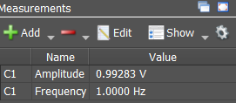

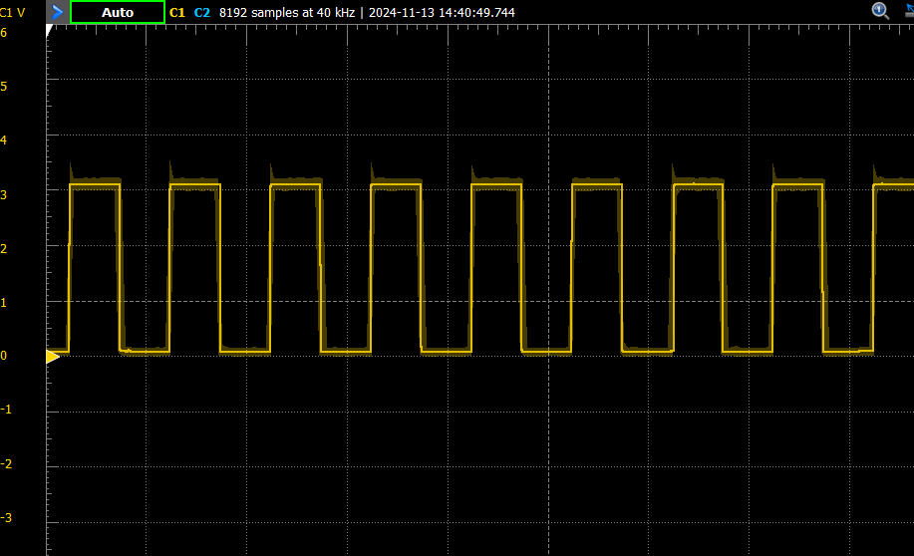
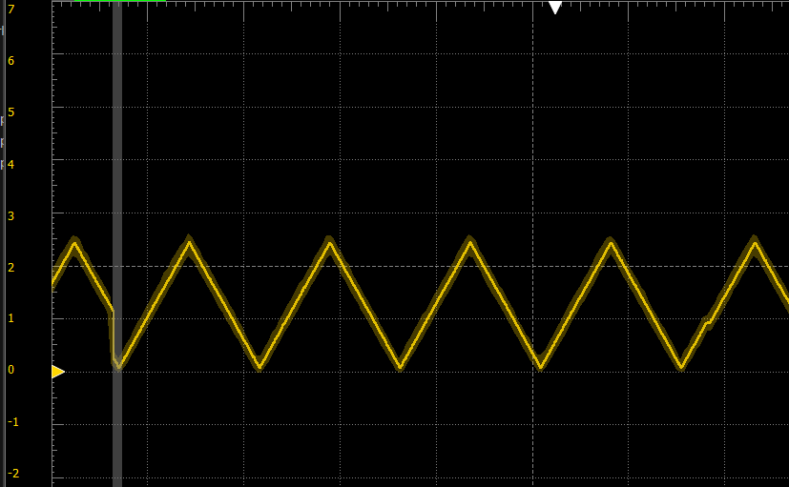
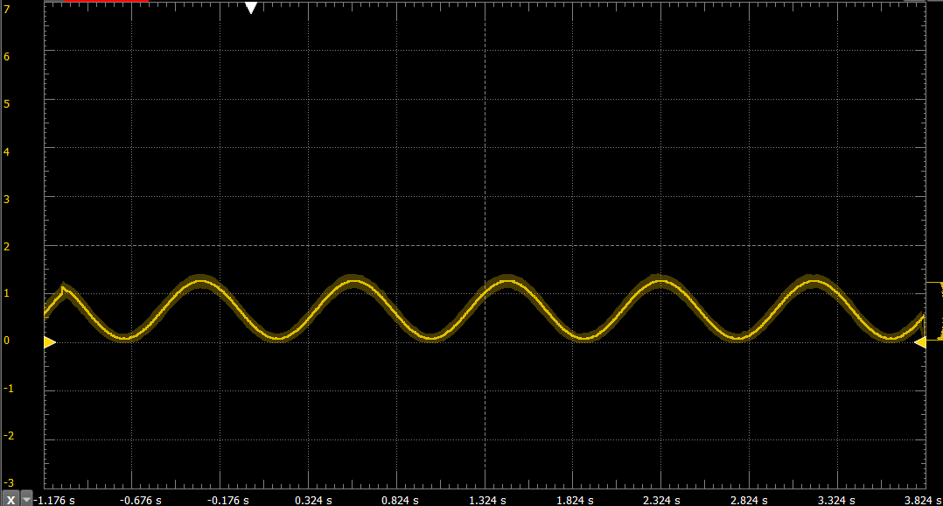
Waveform Generator
Yusuf Hossain
Validation:
Test | Success Criterion | Results
Wavegen Shapes | Produce Sine, Triangle and square waves
Amplitude | 0.5V, 1V, and 2V
Frequency | 1 Hz, 20 Hz, and 30Hz
Wavegen Noise | Output signal is moderately accurate

Slide 8
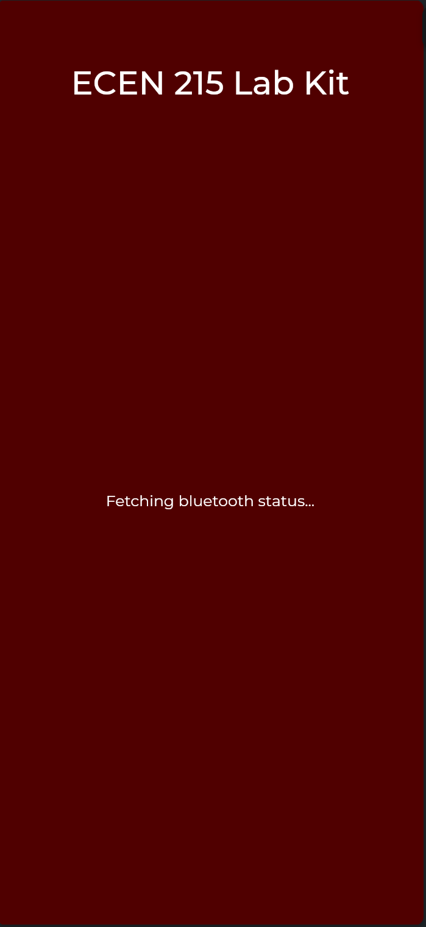
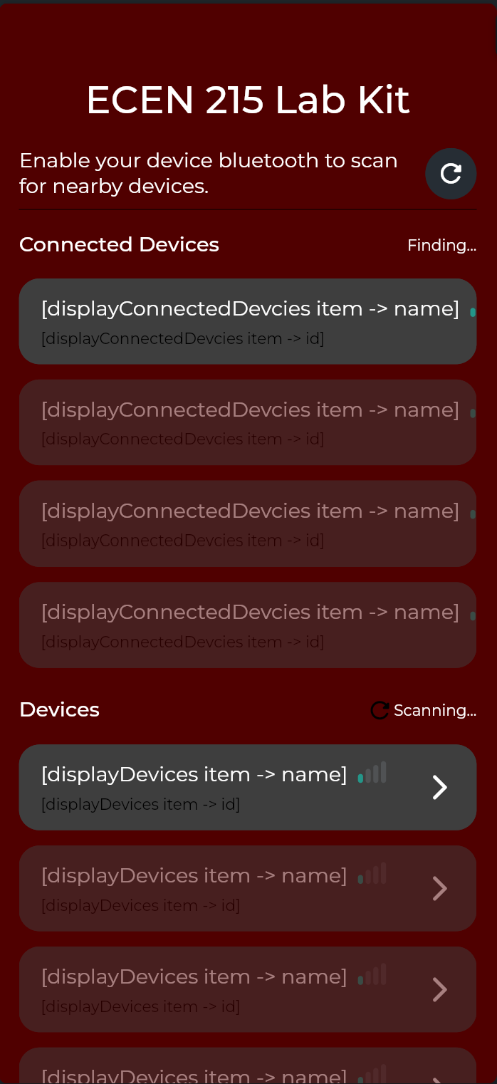
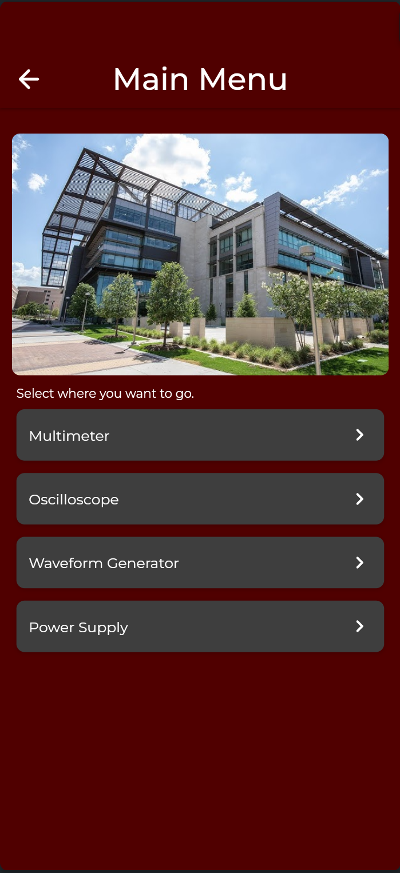
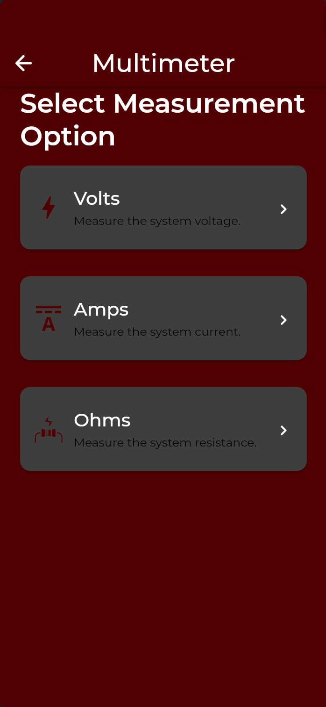


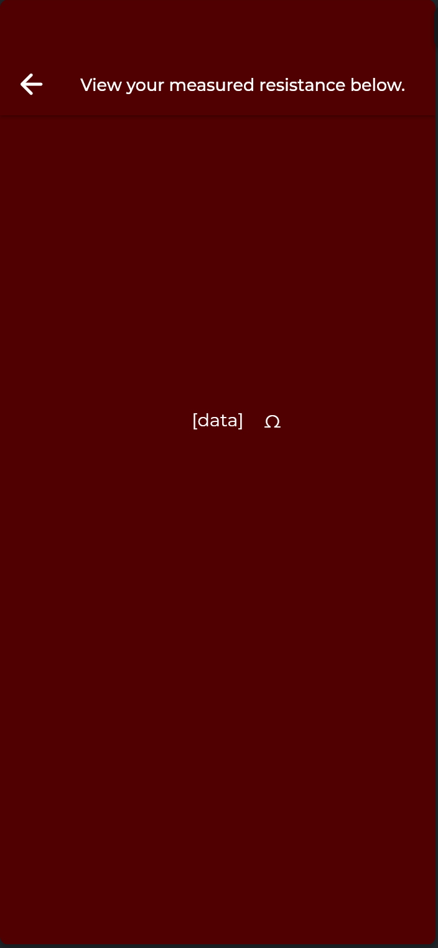
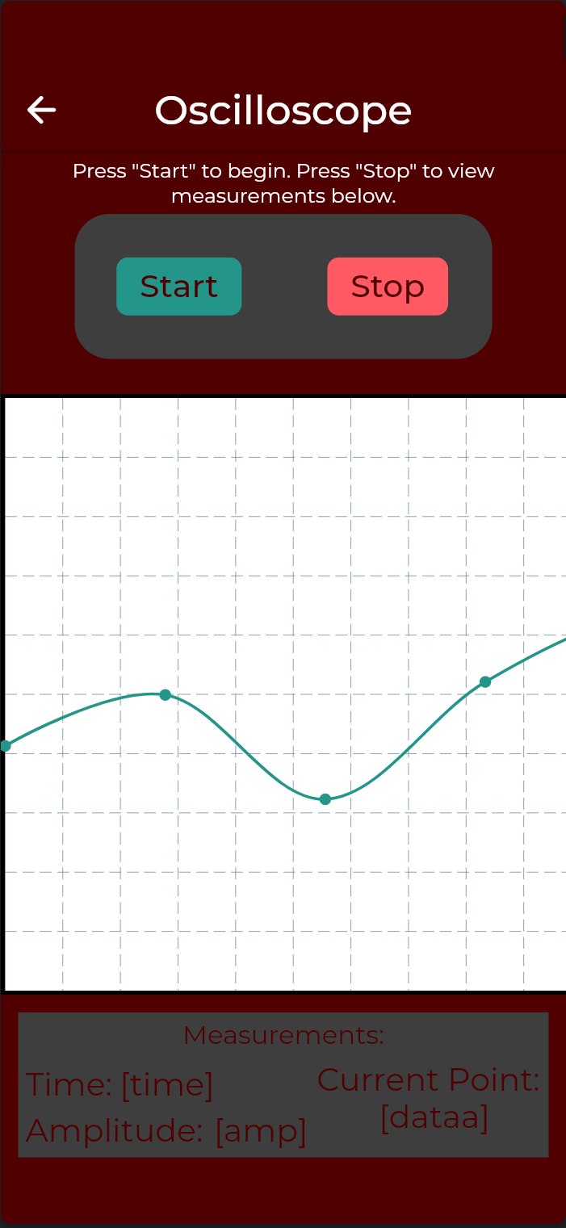
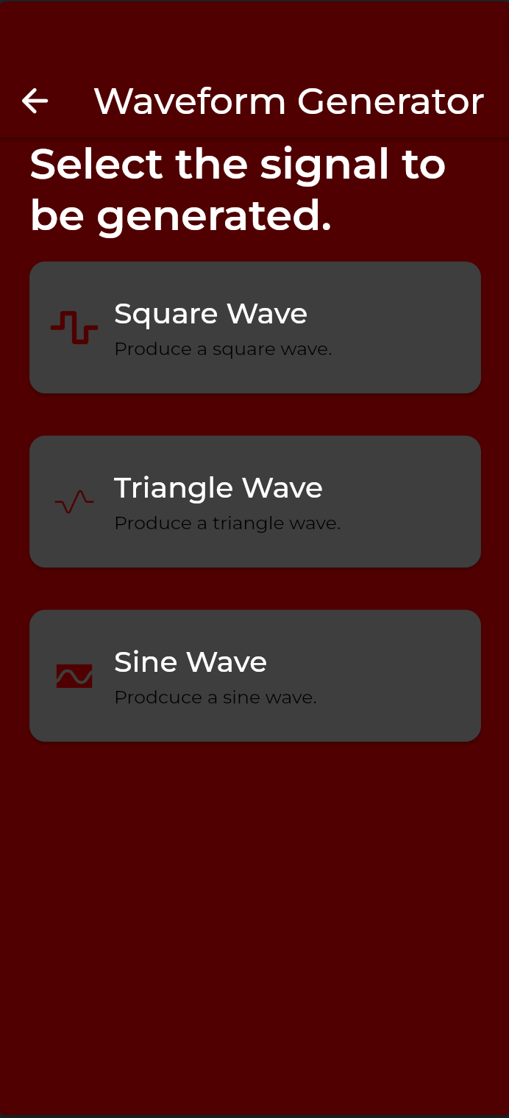
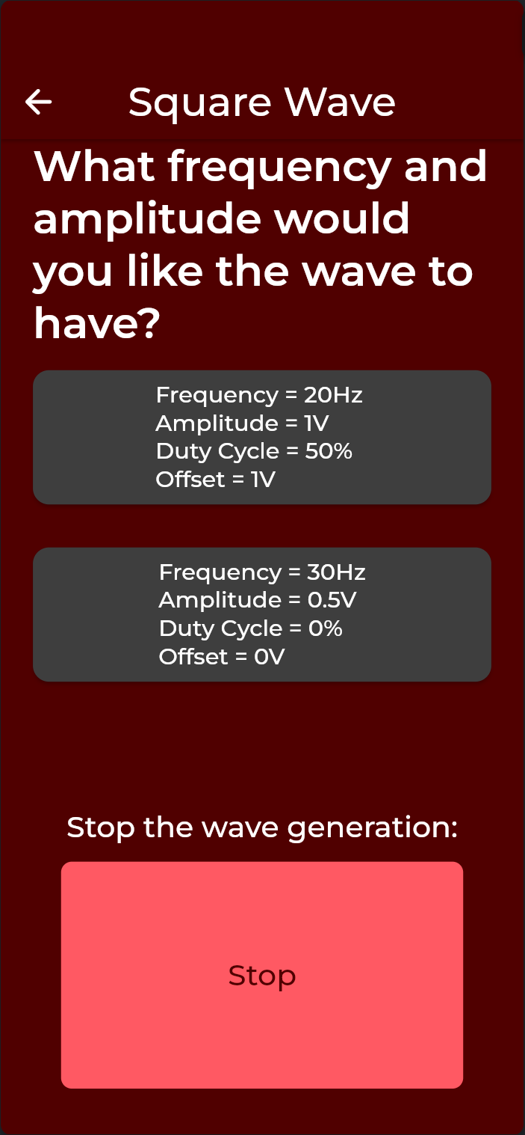
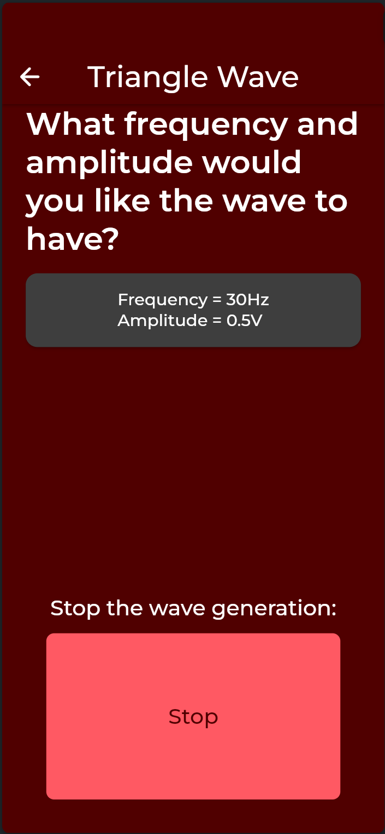
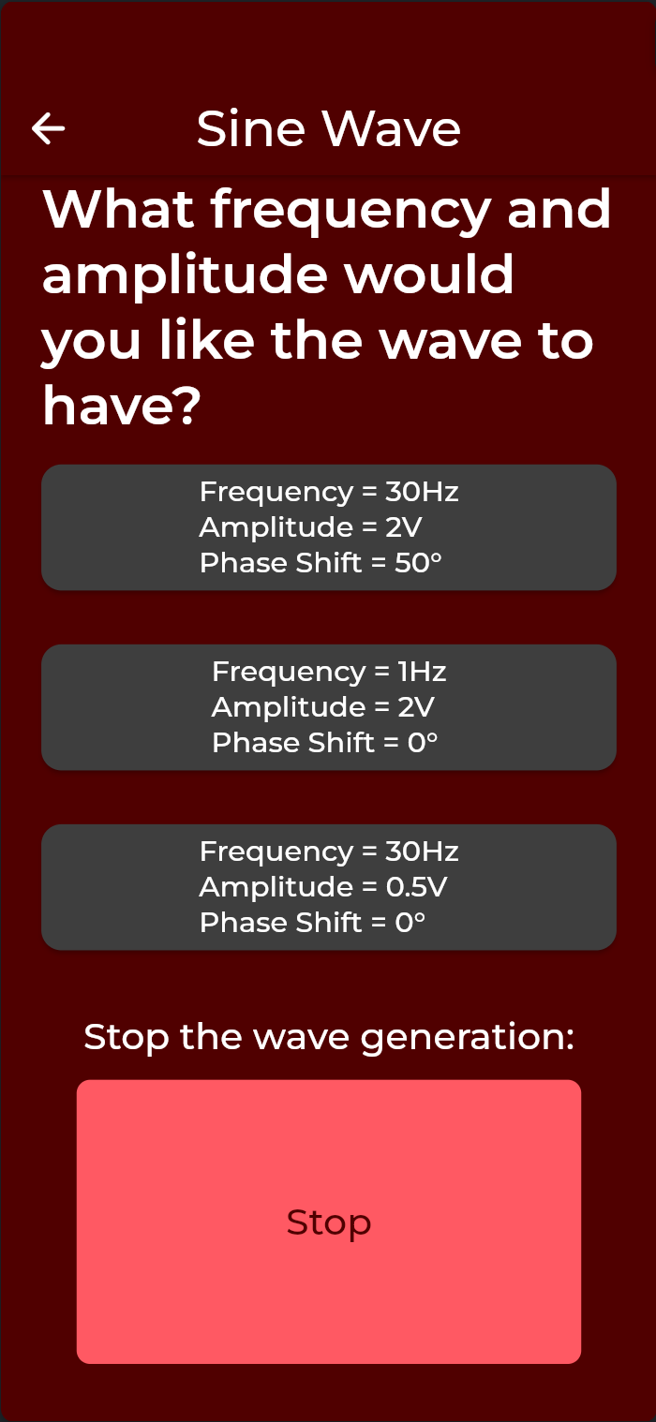

Mobile Application

Slide 9
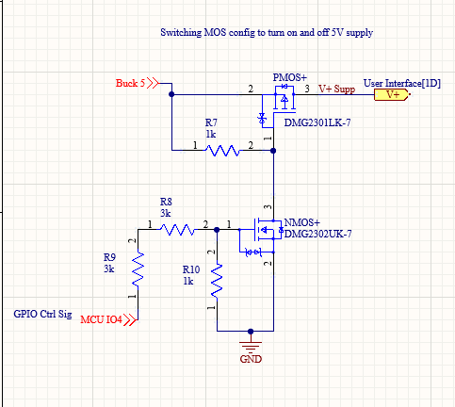
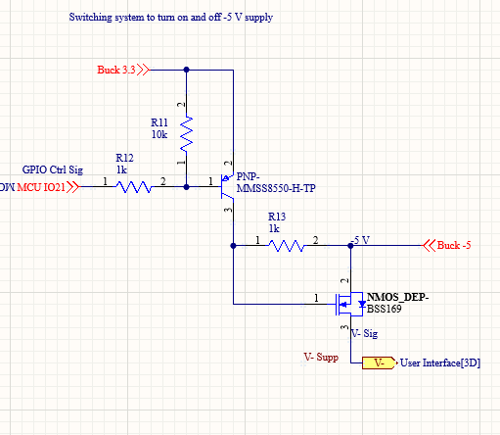
PCB and Power
Ryan Freed
Accomplishments:
Designed Buck Converters
(5, 3.3, and -5 V)
Designed Power Supply
switching system (5 and -5 V)
Designed PCB and case
Low price and size

Slide 10
Mobile App Validation
Discovery:
Devices are discovered within 4 seconds
Connection Stability:
Verified stable connection to device for at least 30 minutes
Reconnection:
App can disconnect from device and reconnect immediately
Read/Write Operations:
Verified app sending/receiving messages through VSCode terminal and system functionality
Connection Latency:
App constantly connects within 1.5 second
Command Response Time:
Data is sent to the app within 0.25 seconds after requesting
Device Compatibility:
App has been installed and operated on multiple devices with various software anywhere from 2 years of age to 10 years of age
Interference:
In performing this demo the app shows stable connection in an environment with abundant BL traffic

Slide 11
Multimeter/Oscilloscope Validation
App-Multimeter Connectivity
Microcontroller sends data through bluetooth to the app from terminal and system functionality
App-Oscilloscope Connectivity:
Graphed oscilloscope readings onto app
Voltage
Expected | Actual | Percent Error
5 V | 4.96V | 0.8%
2.5 V | 2.43 | 2.8%
0 V | .024 | ~~~
Resistance
Expected | Actual | Percent Error
10000 | 9814.343 | 1.89%
1000 | 1005.385 | 0.09%
100 | 108.28 | 7.6%

Slide 12
PCB/Power Validation
Power Systems Results | Expected | Actual
System 1 | 5 V | 4.987
System 2 | 3.3 V | 3.319
System 3 | -5 V | -4.976
Switching System Results | ESP Low | ESP High
Switch 1 | 0.019 mV | 4.93 V
Switch 2 | -4.975 V | -4.973 V

Slide 13
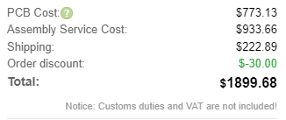
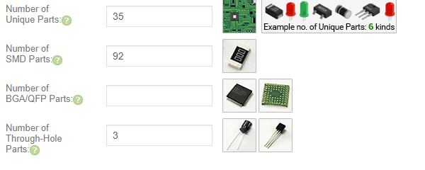
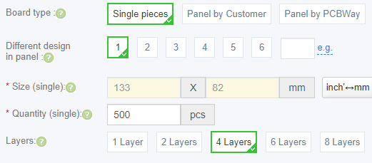
PCB/Power Validation
Price and Size Analysis:
Altium Price Analysis: $44.57
JLC Price Analysis per 500: $3.80
Wall Adapter: $8.83
Overall Estimate: $57.20 per board
Case Size: 156.7x85.6x21.7mm
Area increase vs. phone: 24%

Slide 14
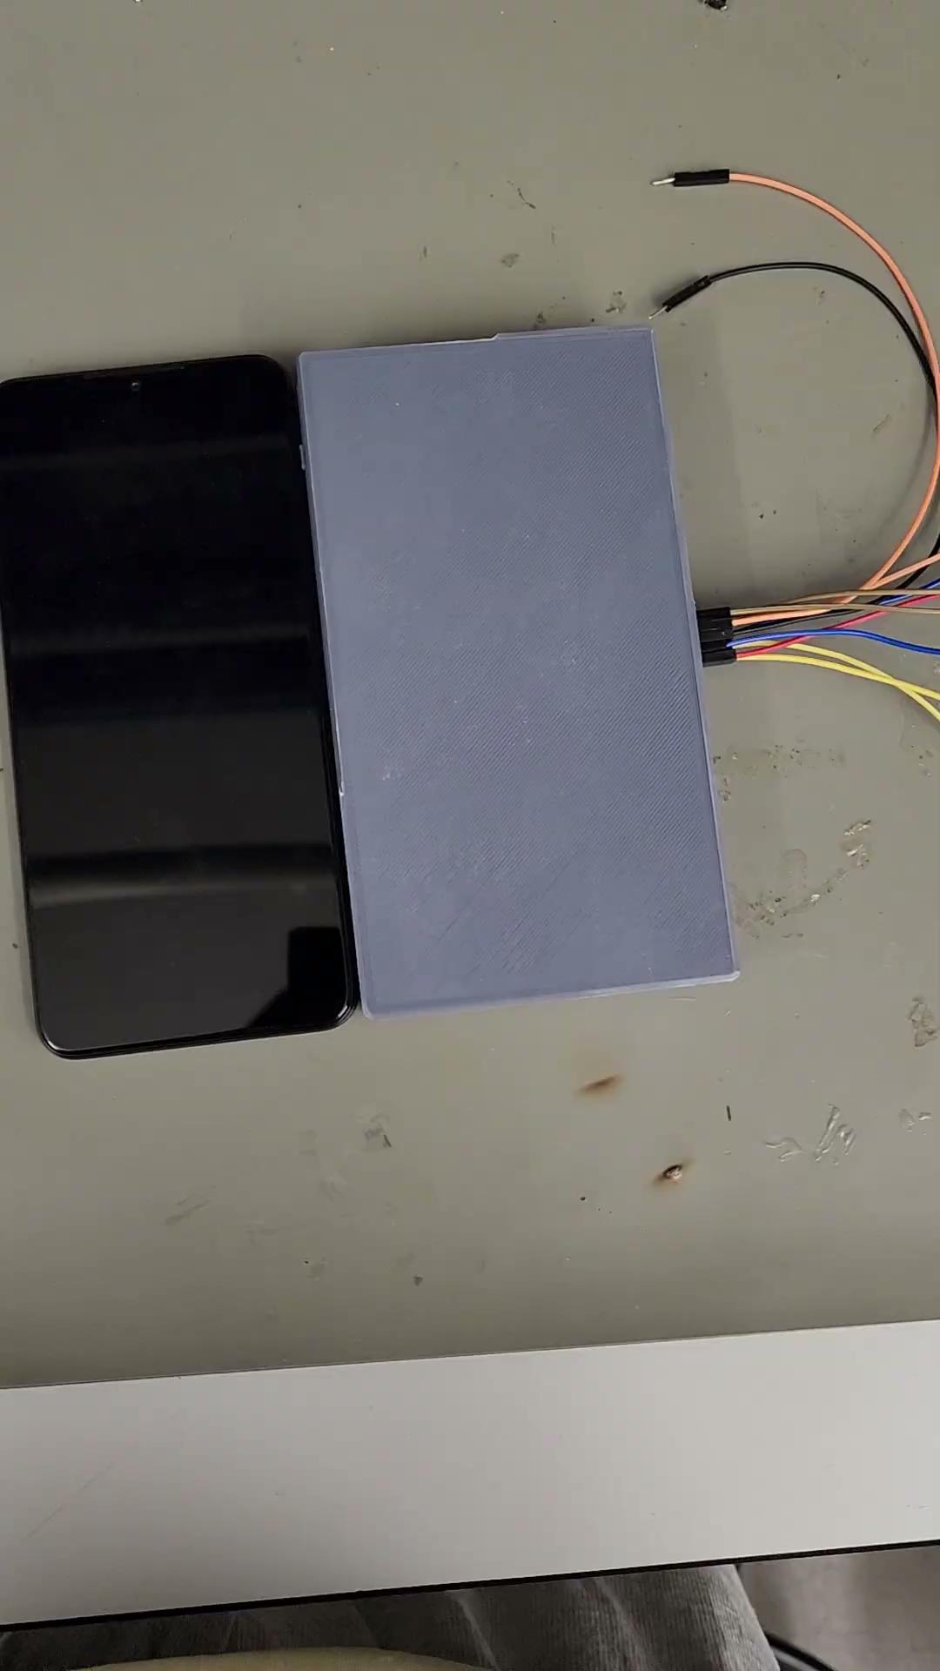
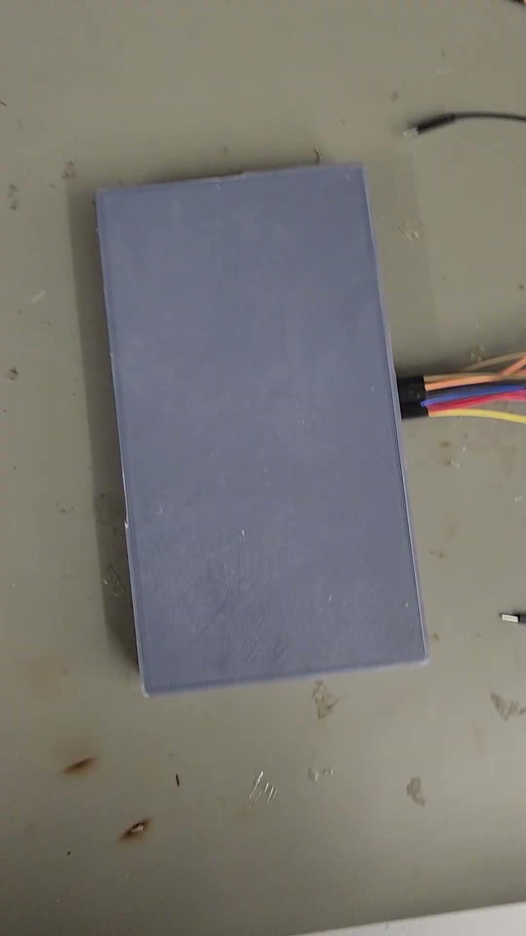
ECEN 215 Lab Kit

Slide 15
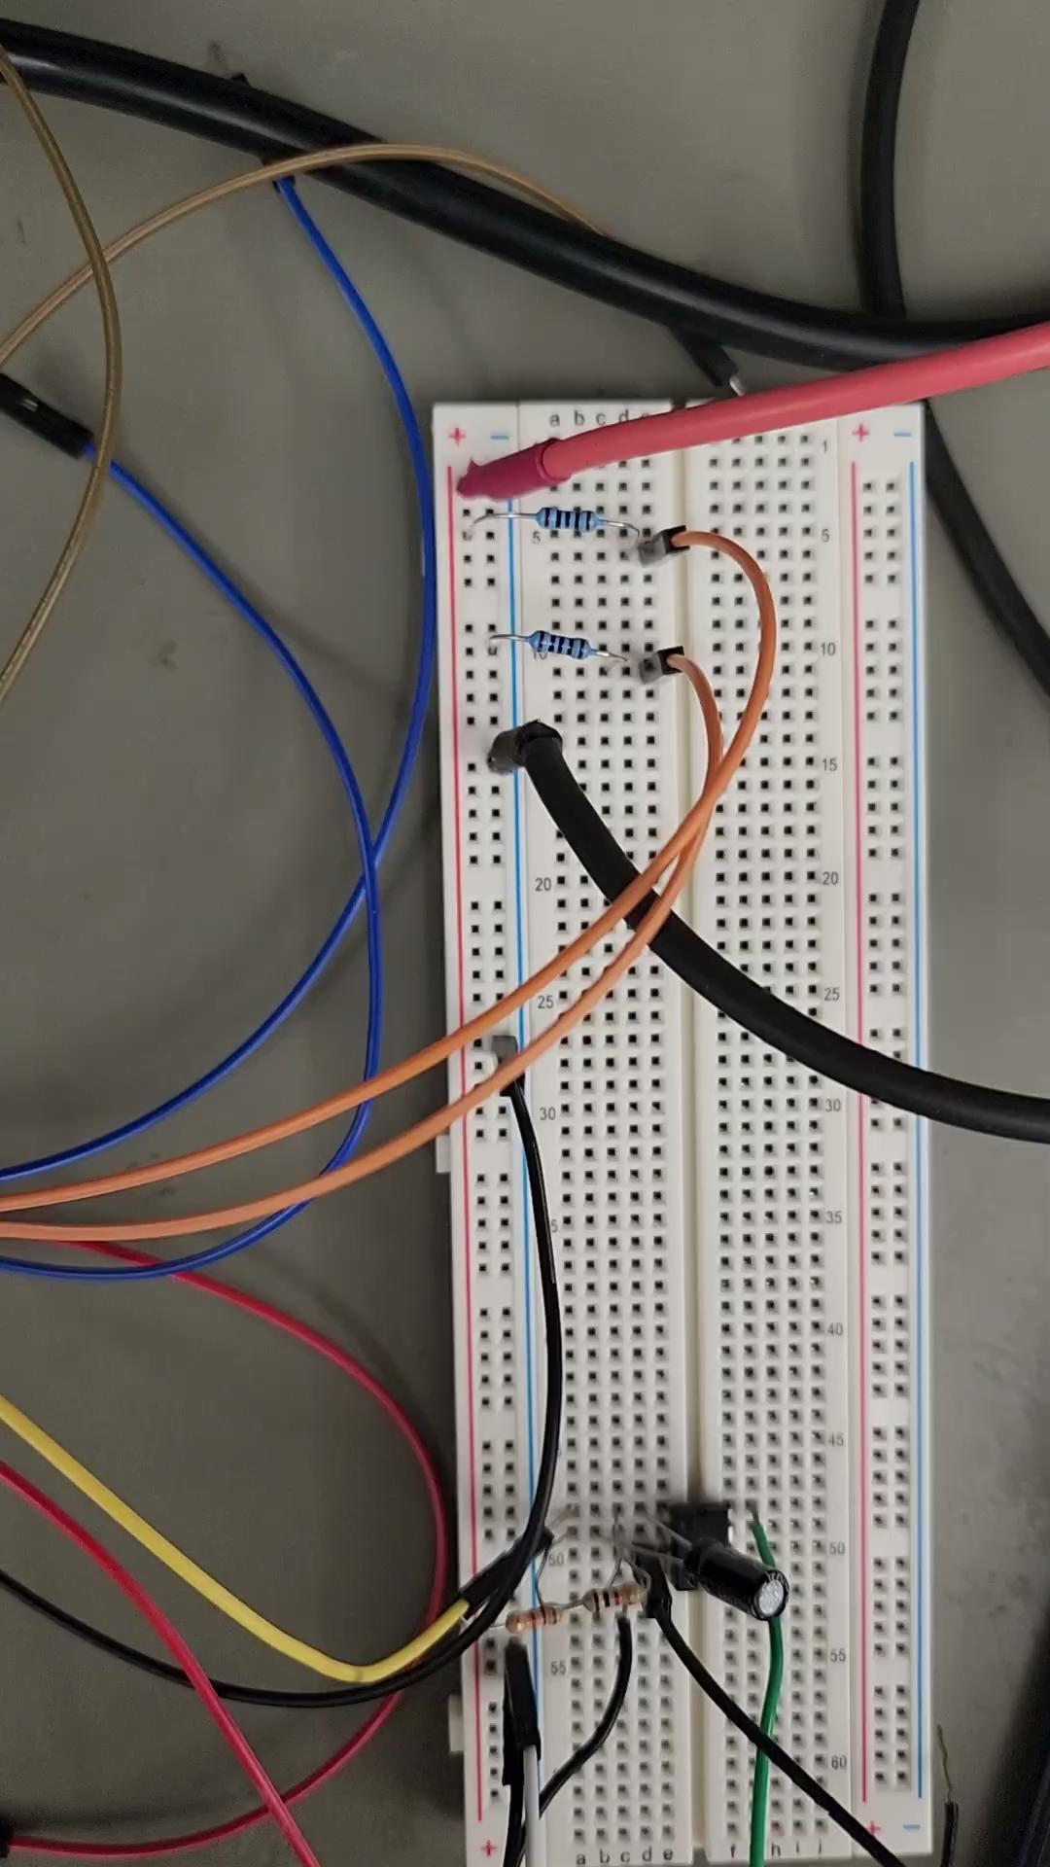
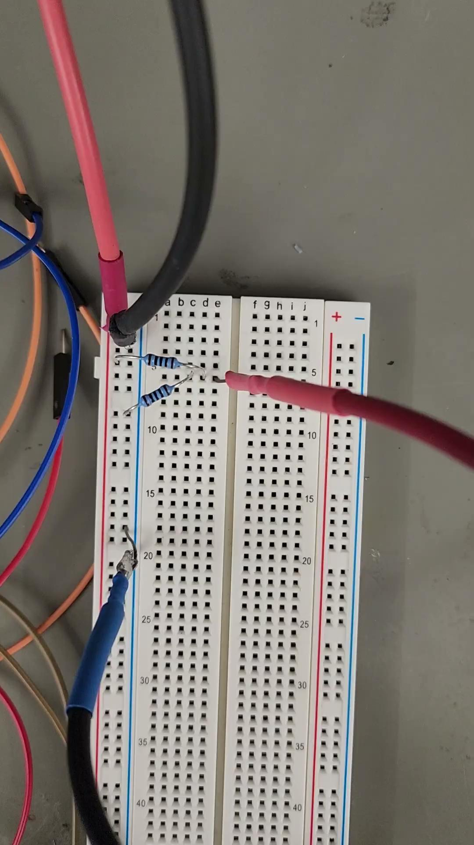
Multimeter:
Ammeter and Ohmmeter

Slide 16
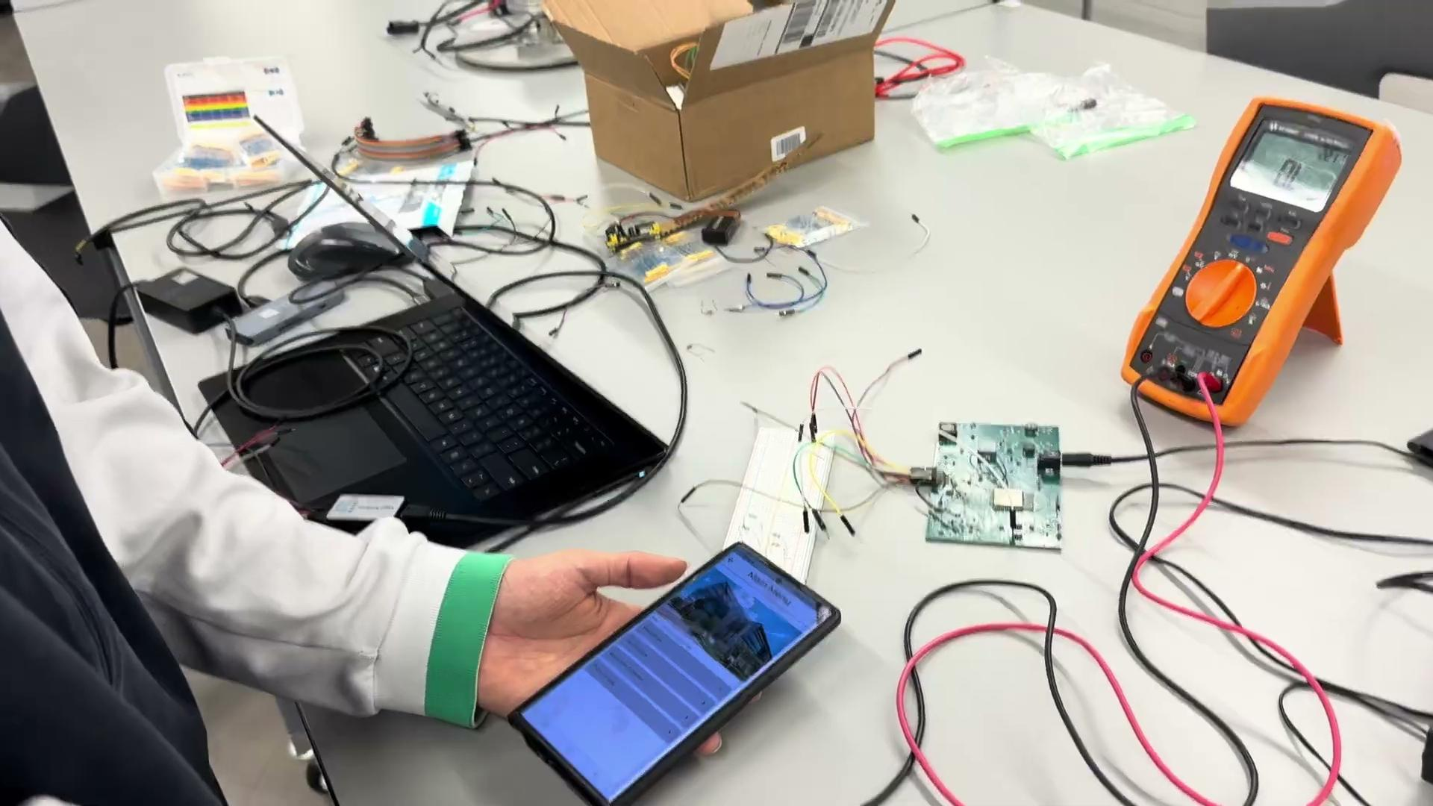
Multimeter:
Ohmmeter

Slide 17
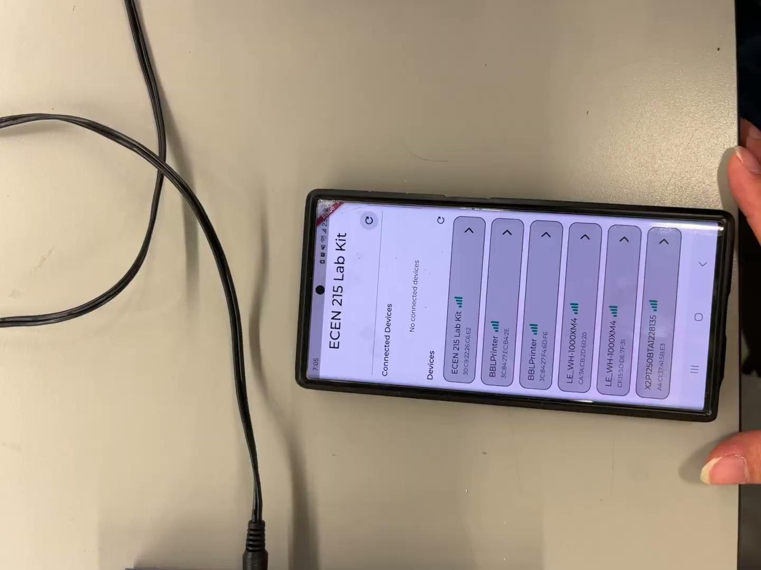
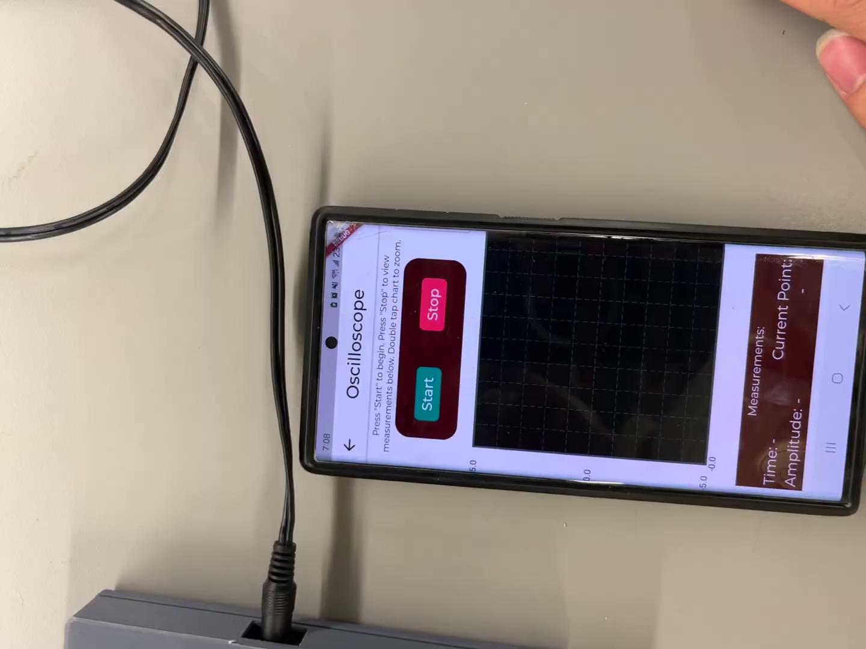
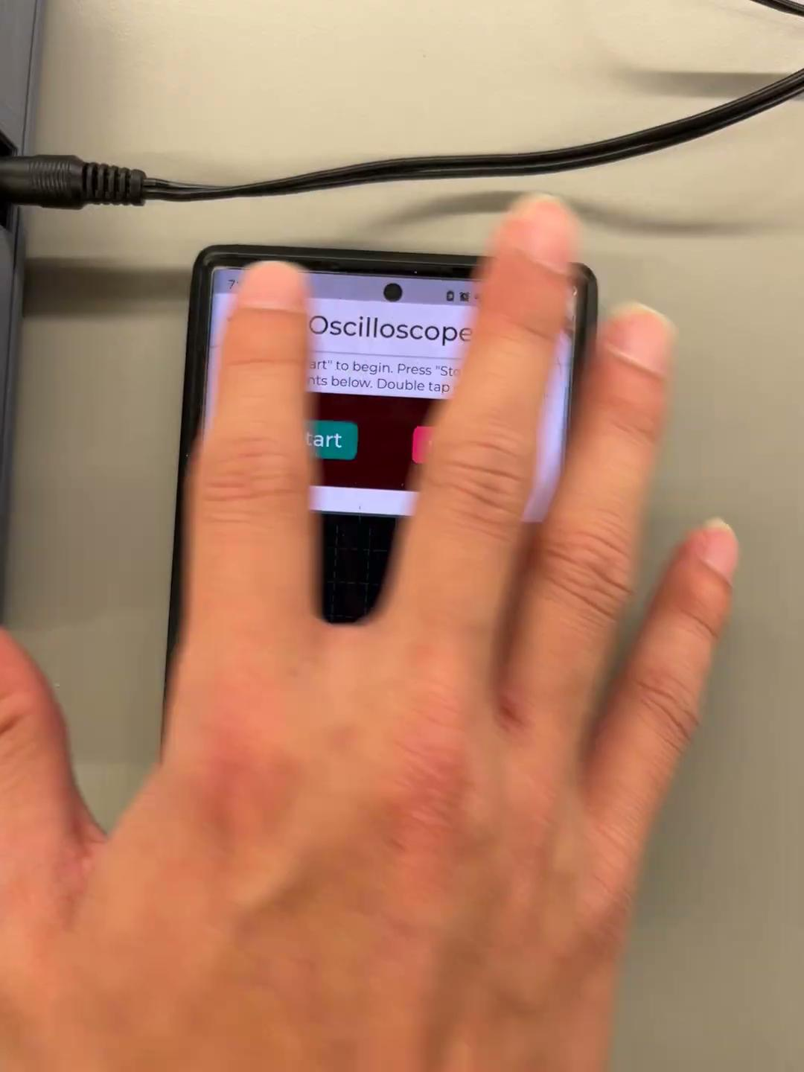
Oscilloscope: Sine, Square, and Triangle

Slide 18
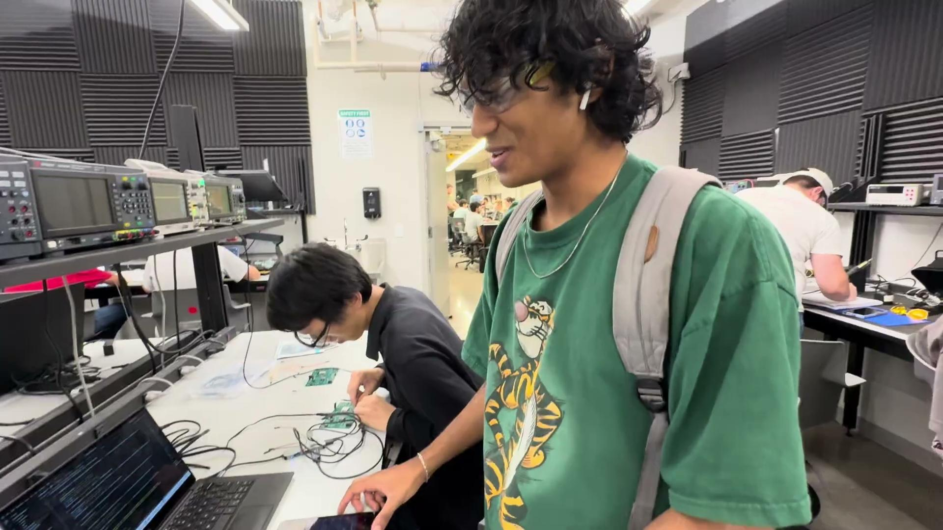
Wavegen: Sine, Square, and Triangle

Slide 19
Thank you

